Slide 1

01
NETWORK DESIGN OF
Kamalapur Railway Station Bangladesh
Submitted By
Mehbuba Alam Oishee 201002162
Shimul Mahmud Rumel 201002248

Slide 2
TABLE OF CONTENTS
INTRODUCTION
01
05
PRACTICAL IMPLICATIONS
IMPLEMENTATION
03
02
OBJECTIVE
02
06
CONCLUSION
ANALYSIS AND OUTCOME
04

Slide 3

INTRODUCTION
03
What is Network?
LAN
WAN

Slide 4
OBJECTIVE
04
To satisfy data communication requirements while minimizing expense.
• To improved performance and efficiency
• To increased security
• To reduced downtime and support costs
• To maintain Scalability, Redundancy, Resilience, Security, Performance, Usability.

Slide 5
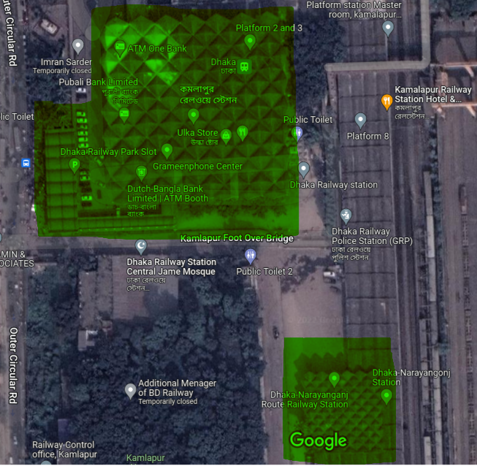
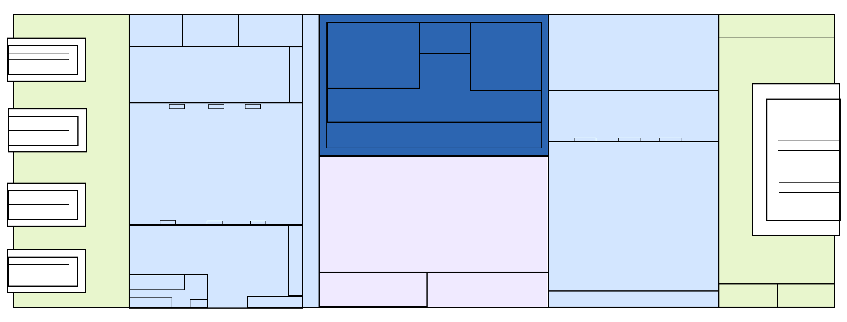
IMPLEMENTATION
05
Google Map of Railway station
Constructed Network Section Diagram

Slide 6
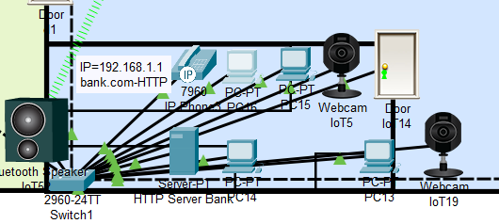
IMPLEMENTATION
06
Design the network of Bank

Slide 7
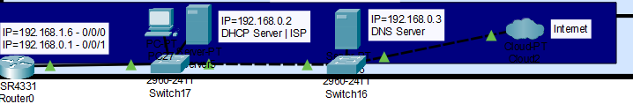
IMPLEMENTATION
07
Design of DHCP and DNS Server.

Slide 8
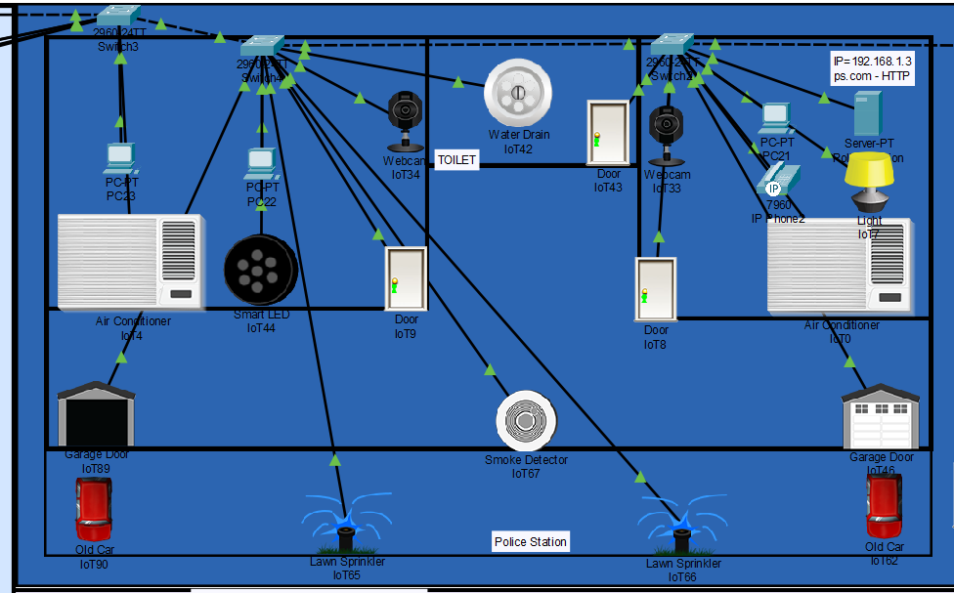
IMPLEMENTATION
08
Design of Police Station.

Slide 9
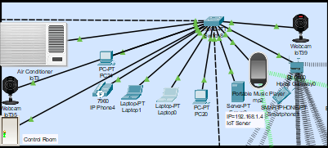
IMPLEMENTATION
09
Design of Control Room.

Slide 10
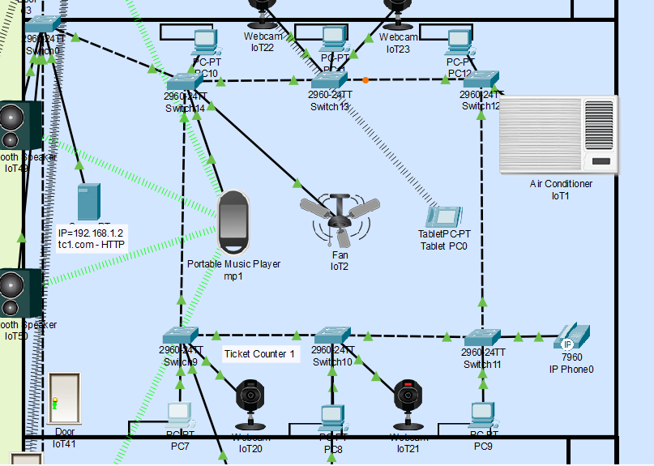
IMPLEMENTATION
10
Design of Ticket Counter.

Slide 11
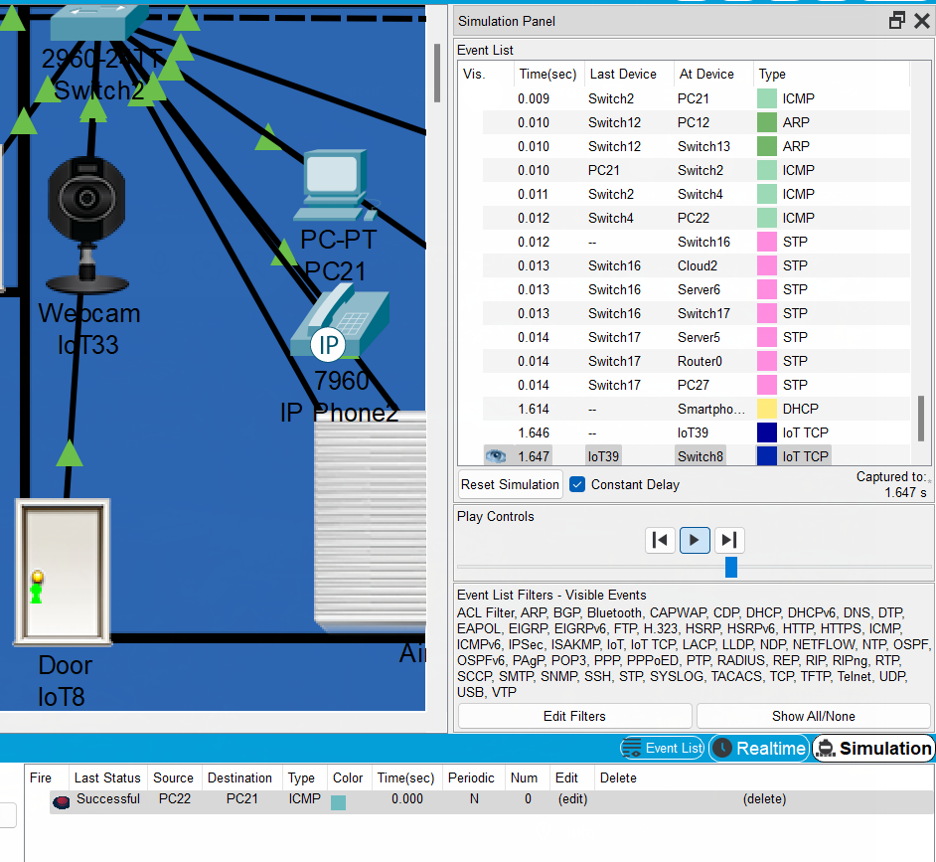
IMPLEMENTATION
11
Simulation of SMTP.

Slide 12
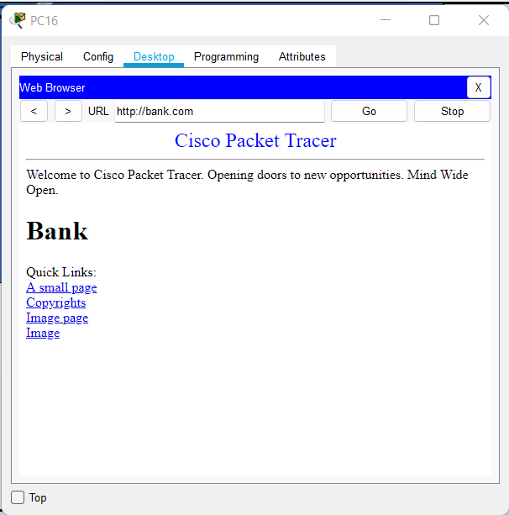
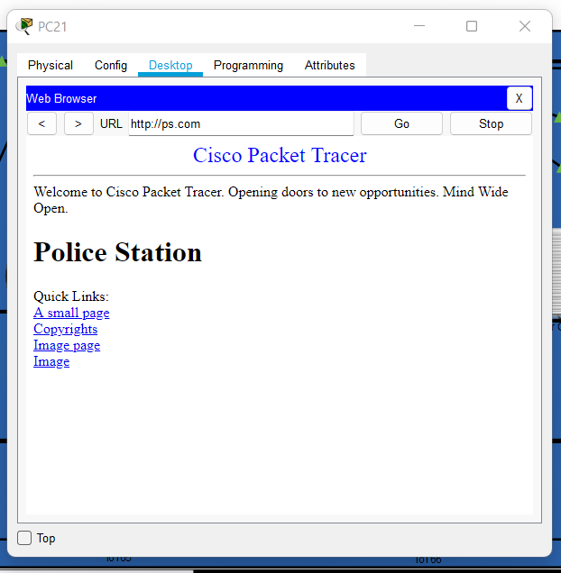
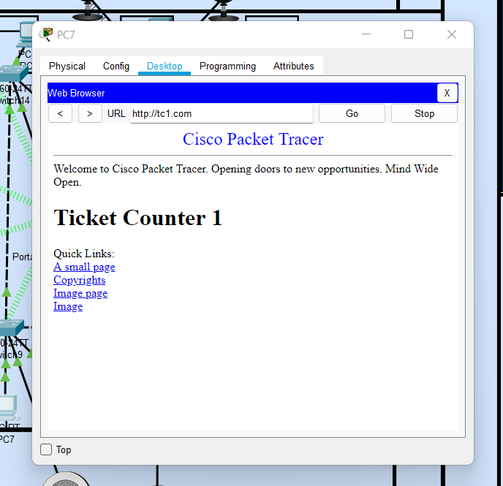
IMPLEMENTATION
12
HTTP server of bank, police station and ticket counter.

Slide 13
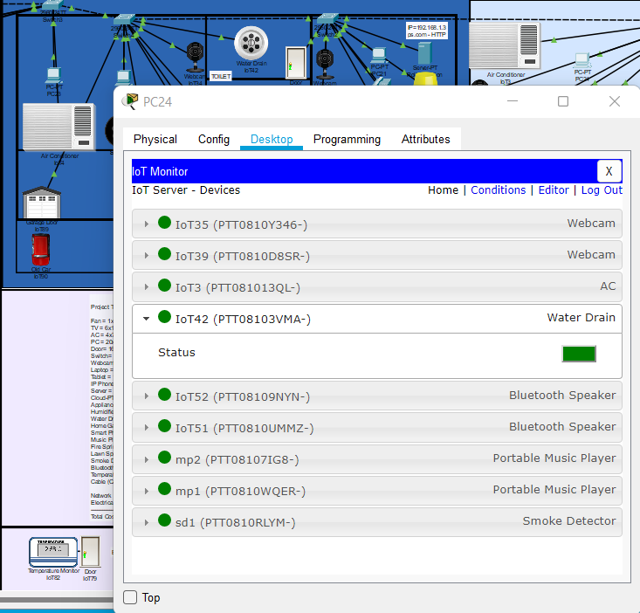
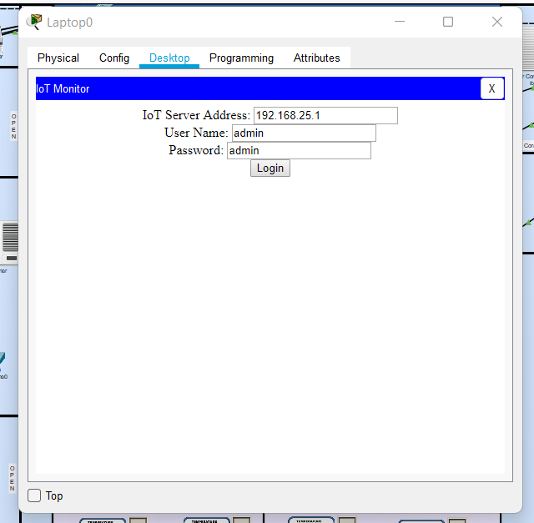
IMPLEMENTATION
13
IOT Control and login.

Slide 14
Practical Implications
14
Can provide a realistic simulation and visualization learning environment as an addition to the technology in education.
Allowing users to examine internal processes which are buried on real devices in real time.
Provides opportunities for multi-user, real-time cooperation and competition for dynamic learning.

Slide 15
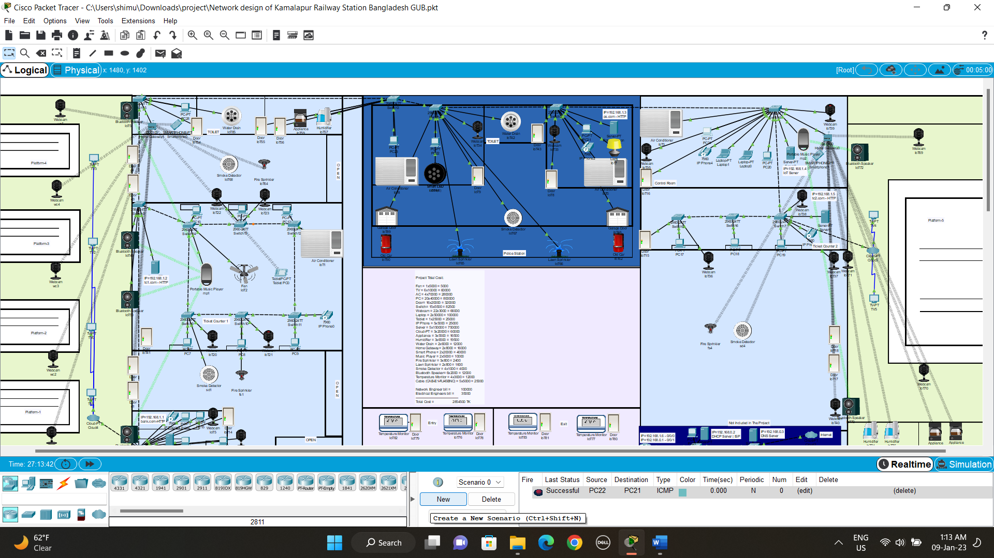
CONCLUSION
15
Our project that is affordable, manageable and expandable.

Slide 16


16
Any Questions?
Thank You.

